Slide 1
12/20/2022
Review and Submit Time to Payroll
Training for Live Import Calls in the New Navigation

Slide 2
Time Dashboard: Approve Timecards
Review Time: Recalculate, Lock Timecards
Payroll: Import Time to Paygrid

Slide 3

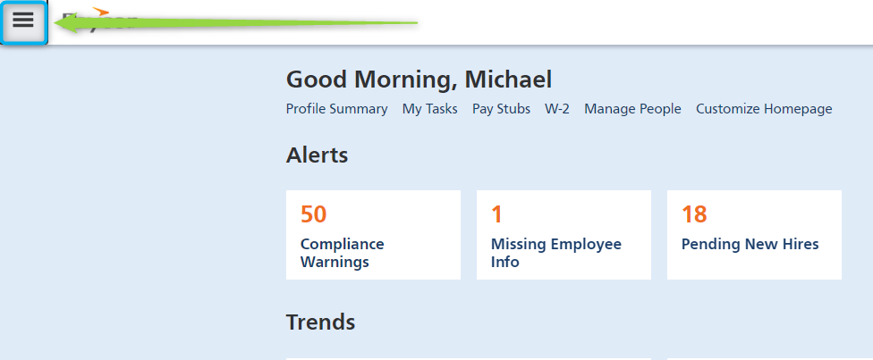

Time Dashboard
Navigation: Click the Hamburger icon > enter Time Dashboard in the Search Navigation box > Click Time Dashboard

Slide 4
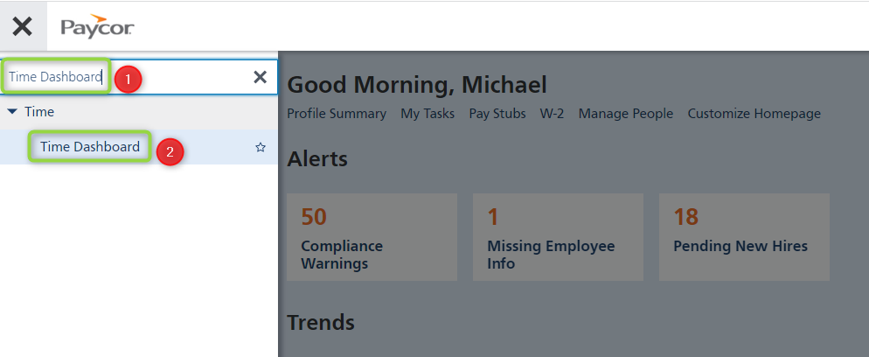
Time Dashboard
Navigation: Click the Hamburger icon > enter Time Dashboard in the Search Navigation box > Click Time Dashboard

Slide 5
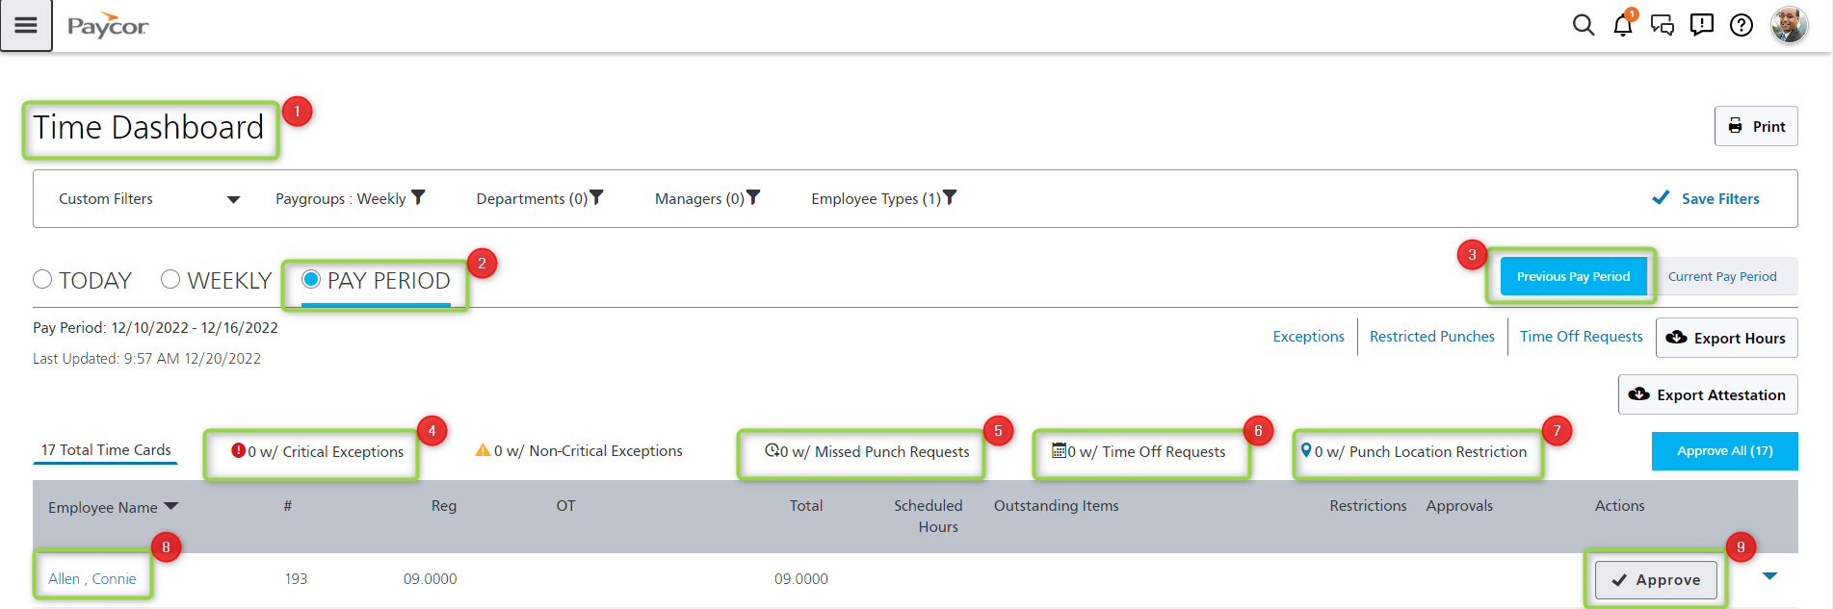
Time Dashboard
The client should always review and approve timecards before locking them; they do not have to, but we do recommend it.

Slide 6
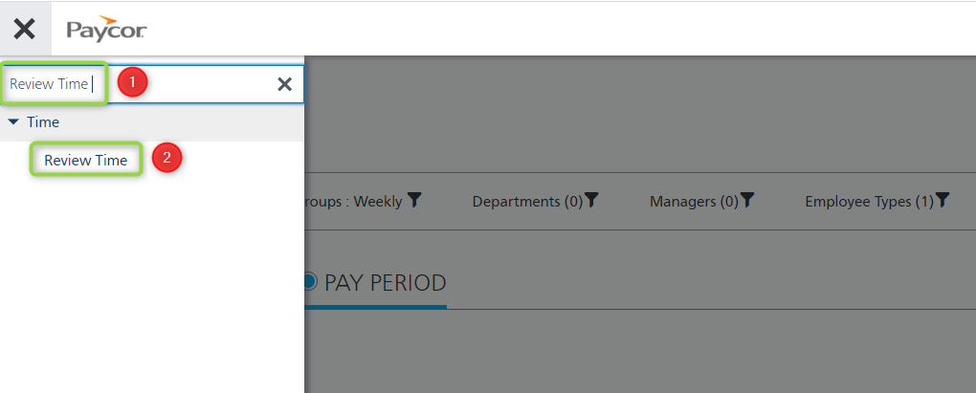
Review Time
Navigation: Click the Hamburger icon > type in Review Time in the Search Navigation box > click Review Time

Slide 7
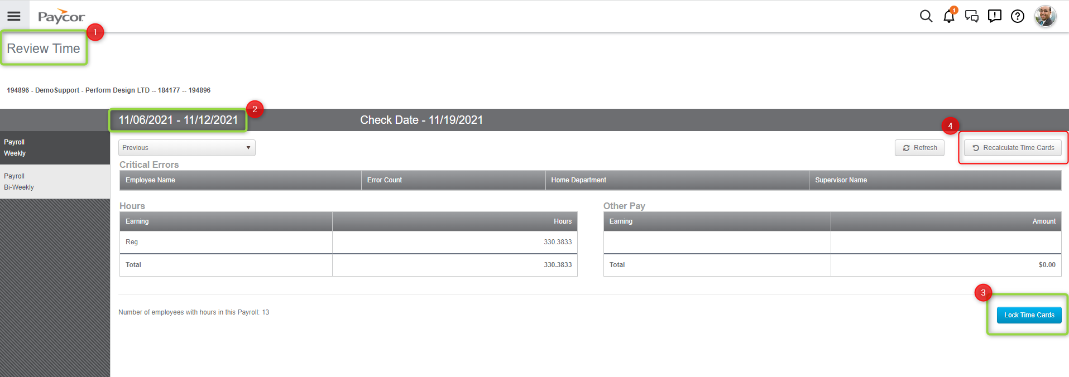
Review Time
The Review Time page is used to lock timecards; locking timecards removes edit access to punches, hours, and pay items for all system users. Exceptions are the only part of the timecard that can be addressed after timecards are locked.

Slide 8
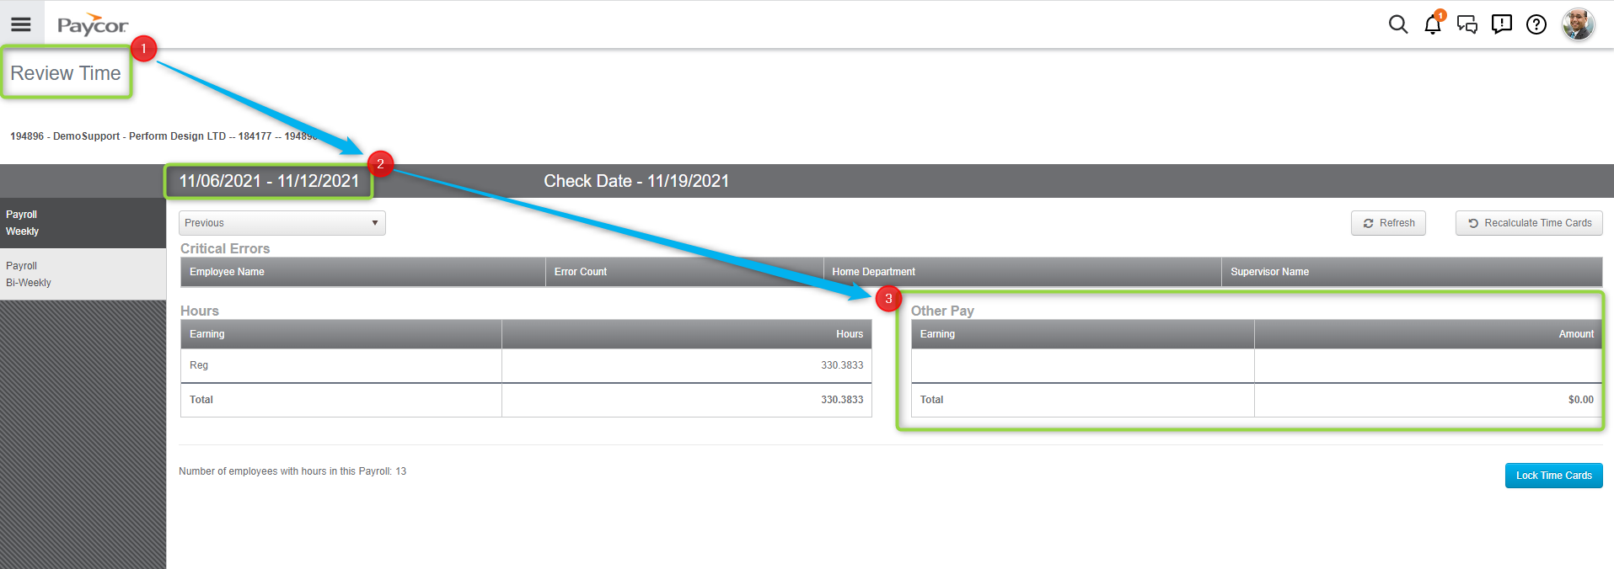
Review Time
In the Other Pay section, be sure to call out if any dollar amounts look out of place; for example: PTO that states $8.00 or $40.00. If the client sees this, it is very likely the EE timecard has a mistake! We want to user Hours, not Pay Items for leave requests on the timecard.

Slide 9
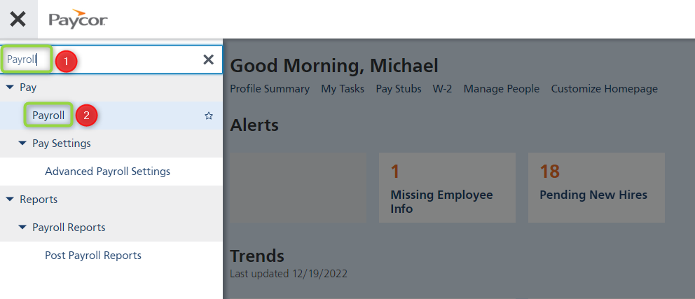
Payroll
Navigation: Hamburger icon > Enter Payroll in the Search Navigation box > click Payroll

Slide 10
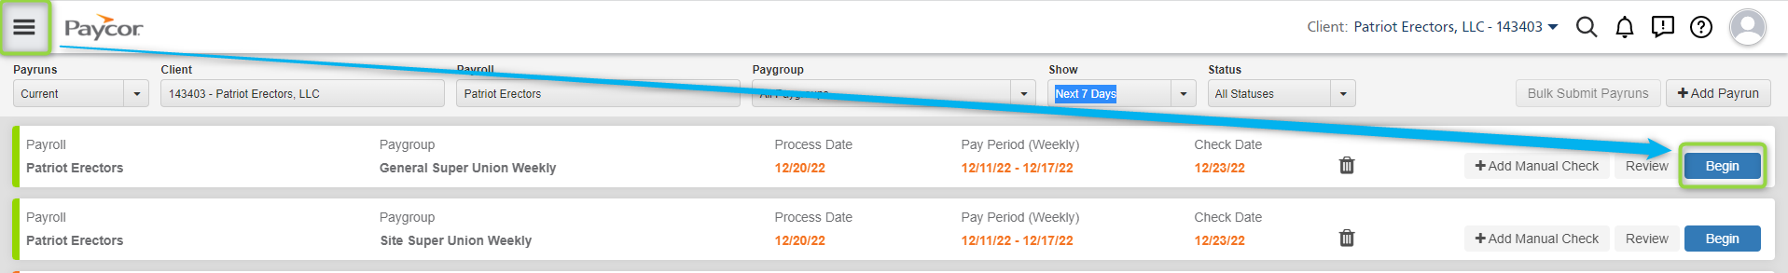
Payroll
Navigation: Click the blue Begin button next to the payrun the client wants to process.

Slide 11
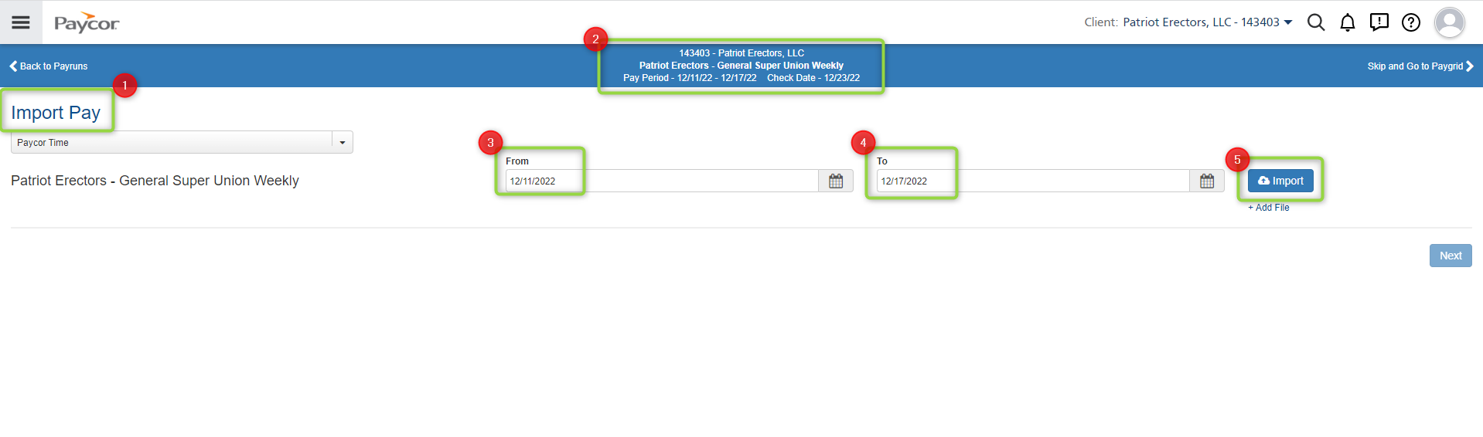
Payroll
Navigation: On the Import Pay page, verify that the payroll dates match the From and To dates > click the blue Import button.

Slide 12
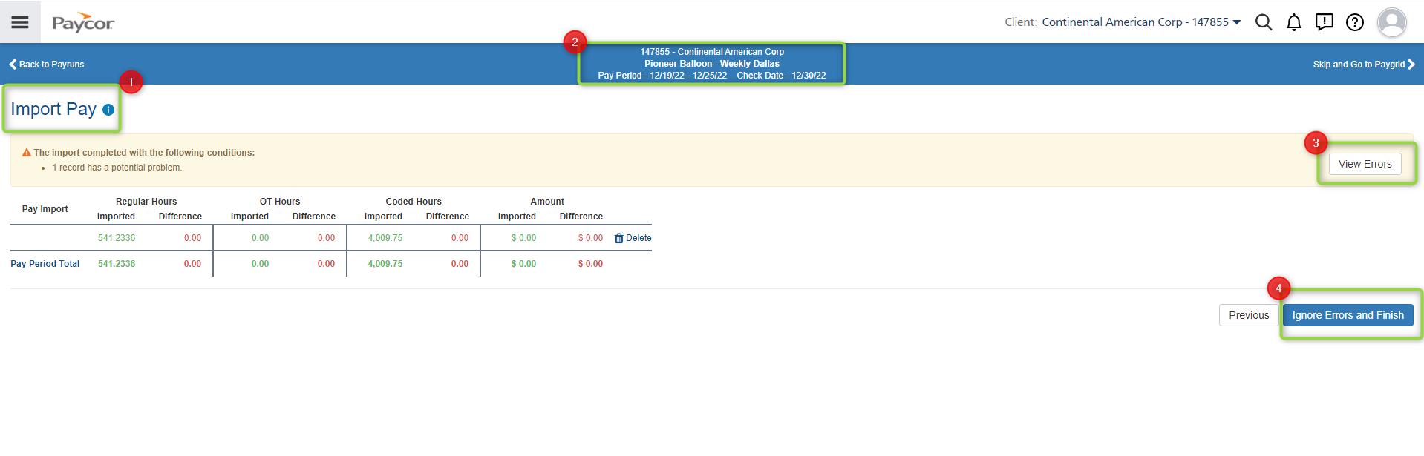
Payroll
Navigation: Click the blue Next button > Click View Errors > Click Ignore Errors and Finish if errors are not showing in Bold font. This will import Time data to the paygrid.

