Slide 1
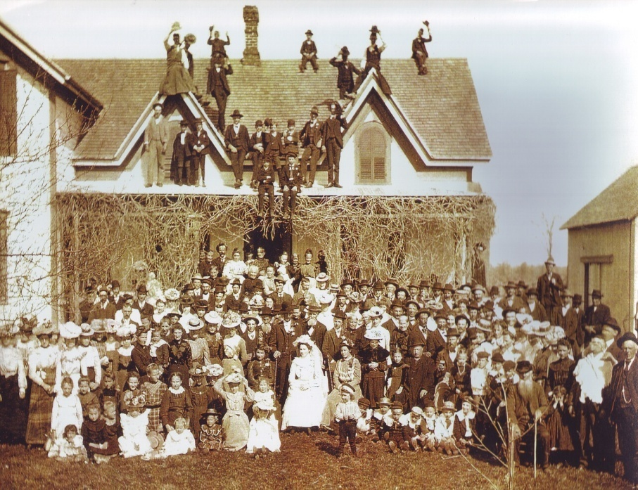
The
Peter & Margaret Bishop
Family Tree
Book
Part 1
By: Kimberly Ann (Bishop) Tobias

Slide 2
The
Peter & Margaret Bishop
Family Tree
Book
Part 2
By: Kimberly Ann (Bishop) Tobias

Slide 3
The
Peter & Margaret Bishop
Family Tree
Book
Part 3
By: Kimberly Ann (Bishop) Tobias

Slide 4


The
Peter & Margaret Bishop
Family Tree
Book
Part 1
By: Kimberly Ann
(Bishop) Tobias
Veitus & Catherine Bishop
Peter & Margaret Bishop
Barvaria, Germany
Alsace-Lorraine, France
Alphonse & Mary Bishop Family
The
Peter & Margaret Bishop
Family Tree
Book
Part 2
By: Kimberly Ann
(Bishop) Tobias
Joseph & Genevieve Bishop Family
Arthur & Marianne Bishop Family
Mary Ann Bishop
Herbert & Anna Bishop Family

Slide 5
The
Peter & Margaret Bishop
Family Tree
Book
Part 3
By: Kimberly Ann
(Bishop) Tobias
Louise & Cornelius Wendling Family
Harold & Rose Bishop Family
John & Helen Bishop
Family
Alfred & Eileen Bishop Family
Coat of Arms
History of St. Michael Catholic Church
Bishop Family Recipes
Descendent Generation List

