Slide 1
Michael & Margaret (Silva) Bishop
8-30-1939
10-13-1938
3512 Sandhurst Drive
Lansing, MI 48911
Married
July 7, 1962
1) Michael Jr.
Born: 1-25-65
Married: Celeste Fata
Date: 4-29-89
Children:
Christina 6-1-91
Marisa 4-22-94
2) Laura
Born: 7-7-66
Married: Thomas Fox
Date: 4-2-00
No children

Slide 2
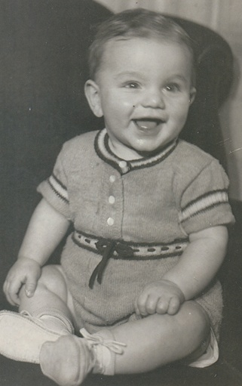
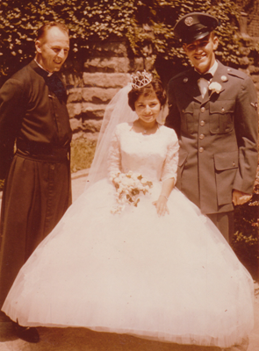
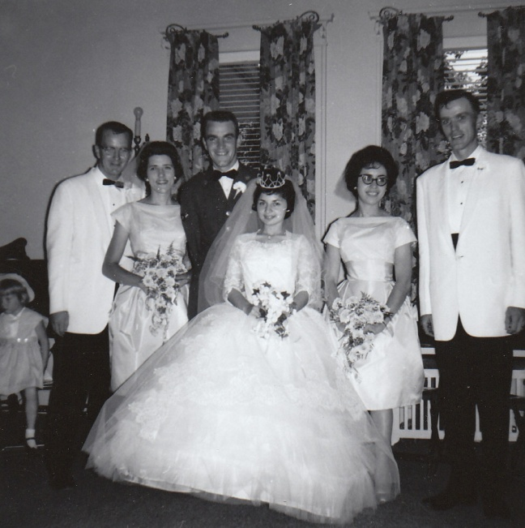
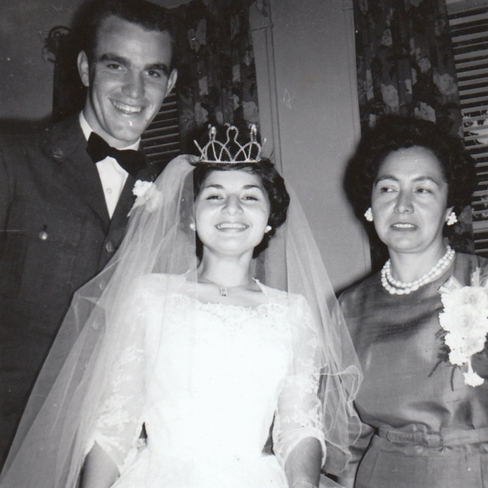
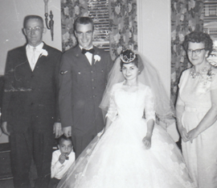
Arthur & Marianne Bishop Family
Child #4 – Michael Alfred Bishop
Left:
Michael
Sr. as a
baby.
Michael & Margaret (Silva) Bishop
on their wedding day July 7, 1962
Michael & Margaret were married
at St. Mary’s Cathedral in
Saginaw, Michigan.
Arthur, Michael, Margaret & Marianne Bishop Michael & Margaret Bishop and Rose Silva
Photos provided by Michael Bishop Sr.

Slide 3
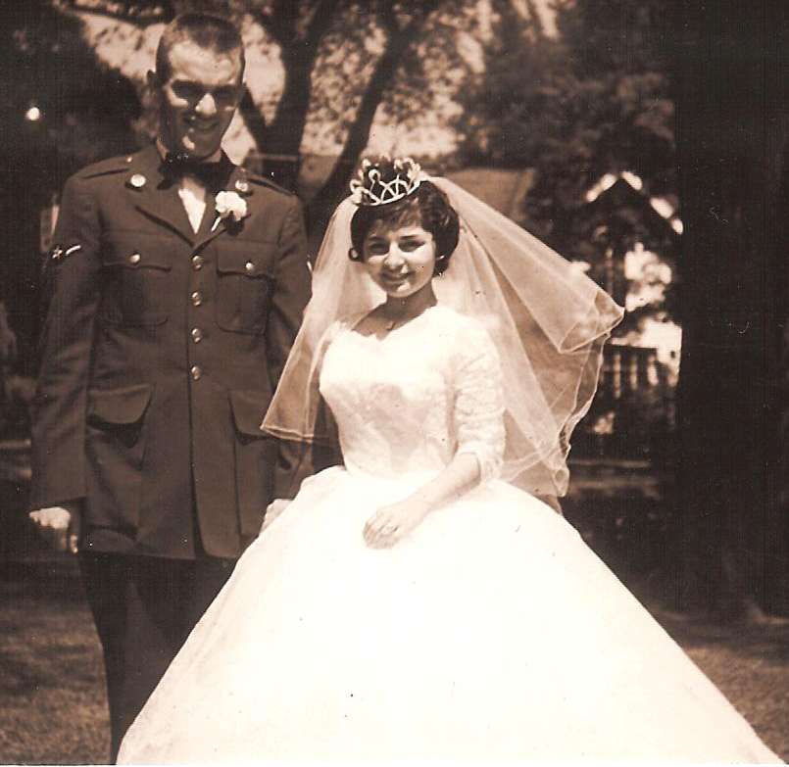
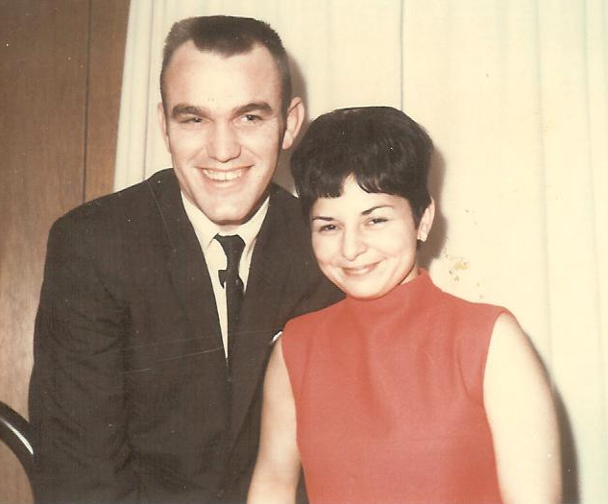
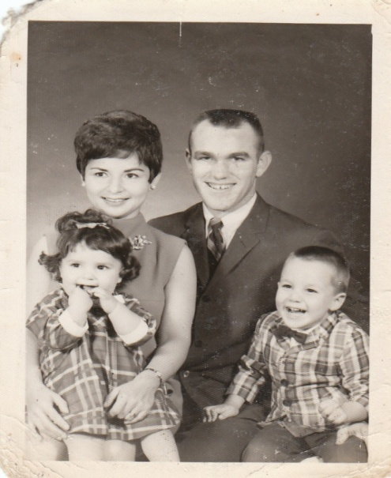
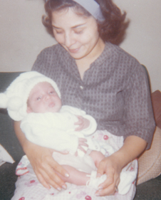
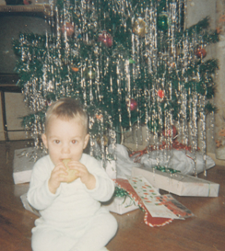
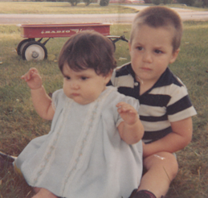
Michael &
Margaret Bishop
Top two photos
provided by
Maureen Bishop
Left: Margaret
and baby,
Michael Jr.
Michael & Margaret Bishop
Child # 1 & 2 – Michael Jr. & Laura Bishop
Left:
Michael Jr.
age 1 at
Christmas.
Bottom
4 photos
provided
by
Michael
Bishop
Sr.
Laura, age 2 and Michael, age 3

Slide 4
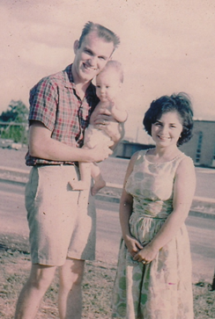
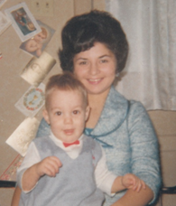
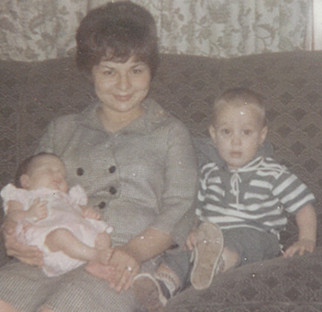
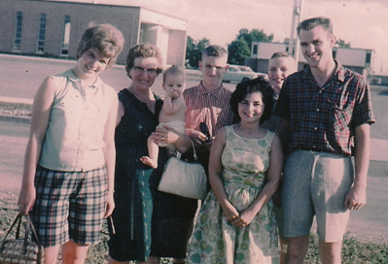
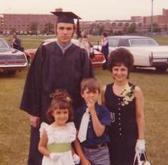
Left: Margaret and
Michael Bishop Jr.
Above, Michael Sr.,
Margaret (Meg) and Michael Jr.
Right: Margaret, Michael and
baby, Laura Bishop
Michael Bishop Sr. graduation
day from Michigan State University
with Laura, Michael Jr. and Margaret.
Photos provided by Michael Bishop Sr.
L-R: Teresa (Bishop) Casey, Marianne Bishop
holding Michael Bishop Jr., Frank & Tony Bishop
in back and Margaret & Michael Bishop Sr.

Slide 5
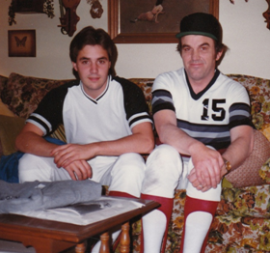
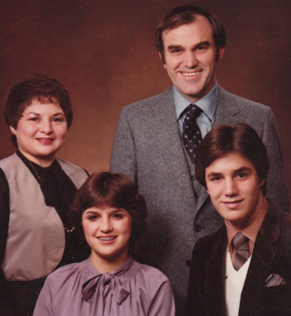
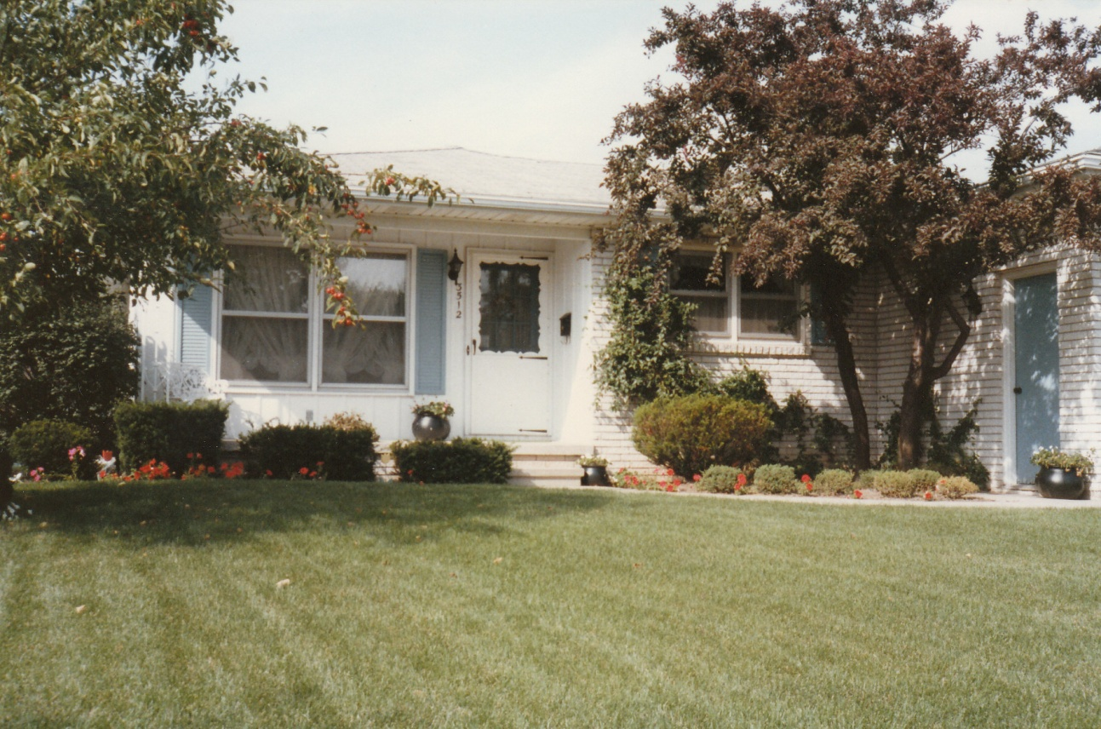
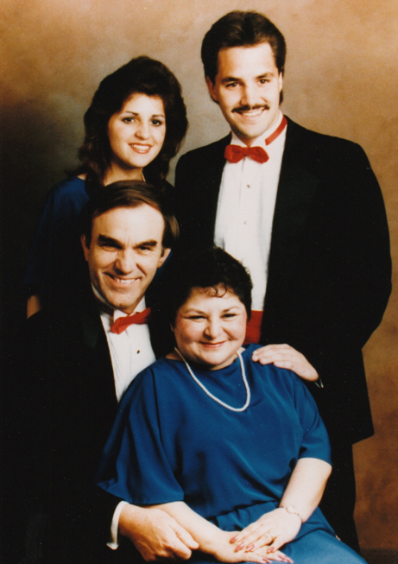
Above: Michael Jr. and Michael Sr. Parrish Painters Softball team players - 1985 (Michael Sr.- coach)
Above: seated L-R: Laura and
Michael Bishop Jr.
Standing: Margaret (Meg) and
Michael Bishop Sr.
Family picture taken in 1981
Above: Michael & Margaret Bishop’s home
located at 3512 Sandhurst Drive in Lansing,
Michigan.
Right: Seated L-R: Michael & Margaret Bishop
Standing L-R: Laura and Michael Bishop Jr.
The photo was taken at the “Stand Up For
America” Performance with Mount Hope Church
-Lansing, MI in 1987
Photos provided by Michael Bishop Sr.

Slide 6
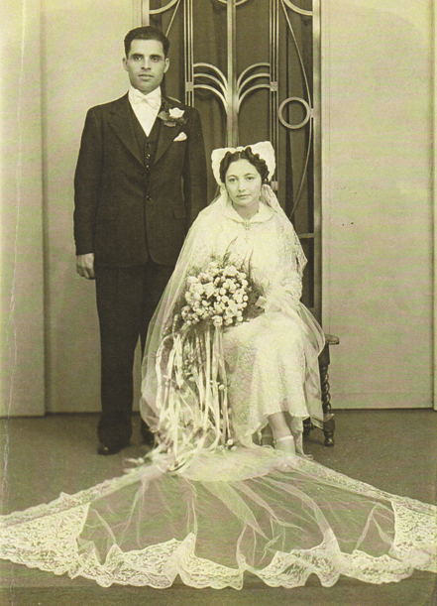
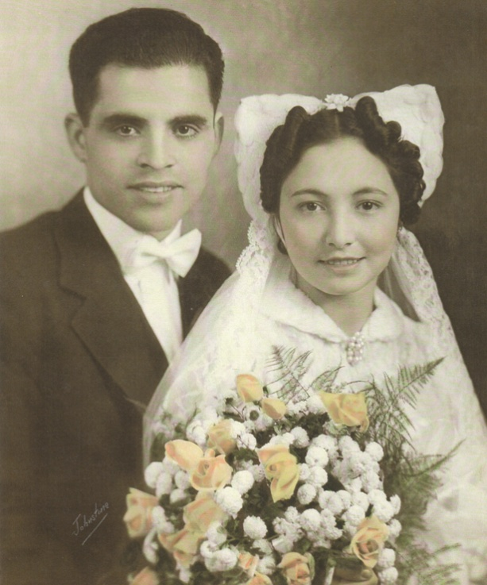
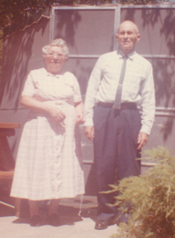
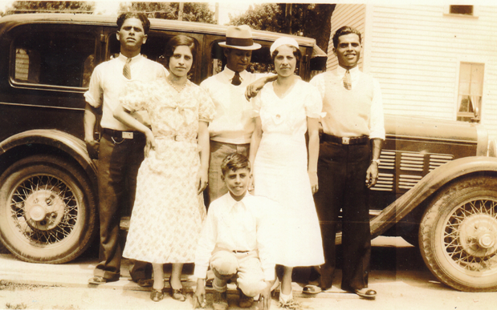
Margaret (Meg) Bishop shared photos of her parents Pete & Rose Silva,
Grandpa and Grandma Silva and siblings. These pictures have been added
them to the book for the benefit of her children and grandchildren and all who
wish to know her side of the family.
P
E
T E
&
R O S E
Above: Grandpa
Luis & Grandma
Brunita Silva
Photos provided by
Michael Bishop Sr.
L-R: Uncle Frank Silva, Aunt Juanita Silva, Uncle Joe Estrada,
Aunt Mary Estrada, Pedro “Peter” Silva (father)
Front (kneeling): Uncle Tony Silva

Slide 7
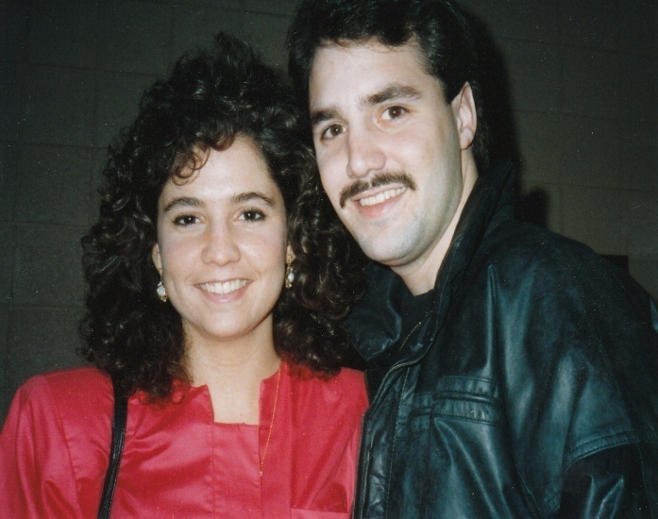
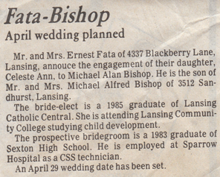
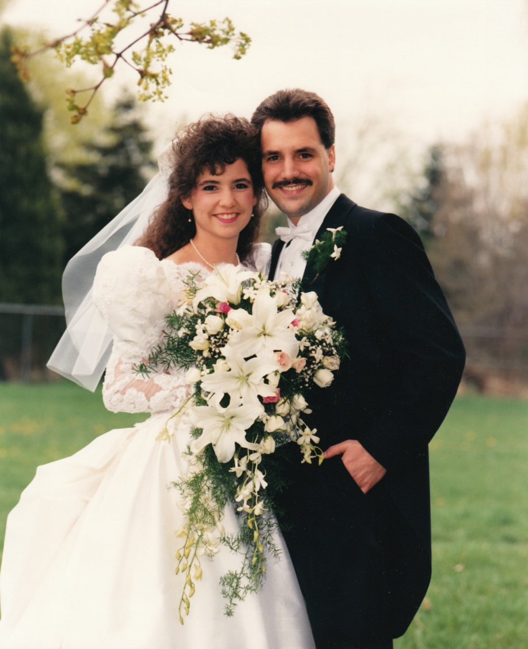
Michael & Margaret (Silva) Bishop Family
Child #1 – Michael Bishop Jr.
Michael & Celeste (Fata) dating
Michael Bishop
and
Celeste Fata
were married
on April 29,
1989 at
St. Gerard Church in
Lansing, MI
Photos provided
by Michael Bishop
Jr.

Slide 8
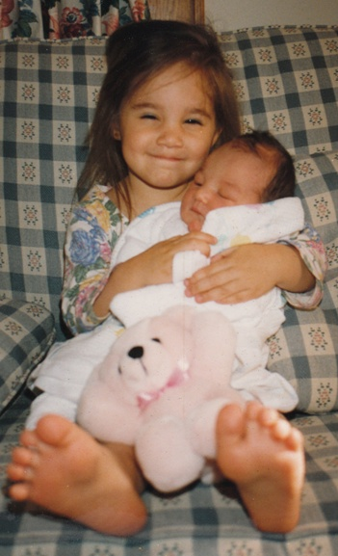
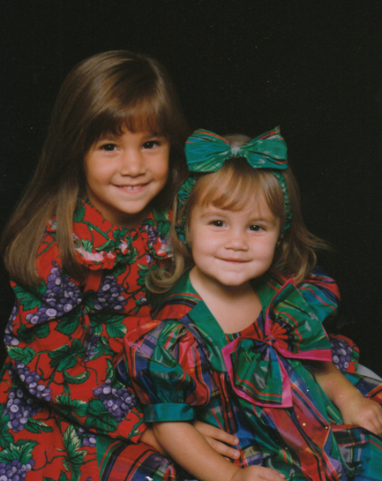
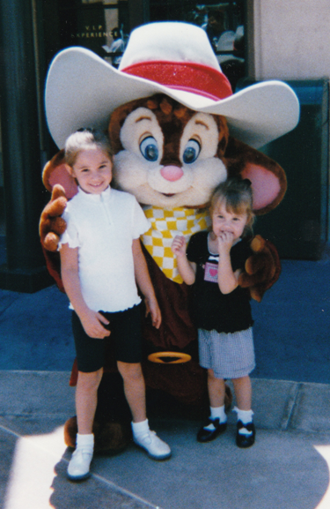
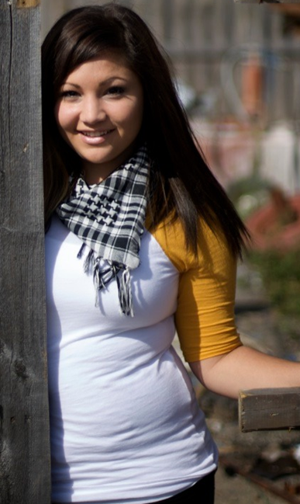
Michael & Celeste (Fata) Bishop Family
Child #1 – Christina Bishop & Child #2 – Marisa Bishop
Left:
Christina 3
with baby
sister
Marisa
Right:
Christina 5
and
Marisa 2
Above Christina (6) and Marisa (3) at
Disneyland.
Right, Christina’s senior photo.
Photos provided by Michael Bishop Jr.

Slide 9
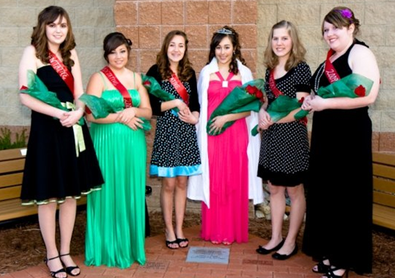

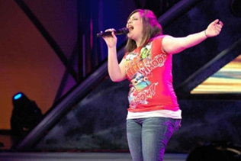

New Covenant Christian
School Homecoming court
Christina, (2nd from left),
Senior Representative
Marisa, (3rd from left),
Freshman Representative.
First time in N.C.C.S. history
that two sisters were
on court at the same time.
Christina performing
for American Idol
at the MGM in
Orlando, Florida.
Just think, if the
entire Bishop
Family had known,
we could have
given her over
400 votes… ☺
Well maybe not
from the little ones
but close.
Marisa Bishop singing at
her youth group -SPYN .
Since singing in the
family is a Bishop trait,
it’s good to see members
performing.
Photos provided by:
Michael Bishop Jr.

Slide 10
Michael and Celeste Bishop
I, (Mike), graduated from JW Sexton High in 1983 and Celeste graduated from Lansing Catholic Central in 1985. Celeste and I married on April 29, 1989 at St Gerard’s Church in Lansing. Both Celeste and I both graduated from Spirit Life Christian College in Irvine, California in 1997. We lived in California for 3 years in Costa Mesa, Irvine and Escondido. We currently reside in Lansing, MI with our 2 daughters Christina –19 and Marisa -16.
Our family attends Mount Hope Church where we have been members since 1986. Our whole family has been involved in music at Mount Hope and I, (Mike), am a Deacon and serve on the church board as well. Christina and Marisa are both active in the church youth group where both of them lead worship with both singing and playing keyboard/piano.
Celeste and I both work for her family’s business called the Labor Law Poster Service where I am the Operations Manager and she is the Data Department Supervisor. Marisa also works in the data department. Christina did work with us in the Customer Service and Data departments (and still occasionally does) but left to take a position as an Salon Attendant at Douglas J Salon in Okemos, MI.
Christina graduated from New Covenant Christian School in 2009 and has attended Lansing Community College taking classes within the music curriculum. She has taken some time off from L.C.C. to do an internship at International House of Prayer in Kansas City, MO. Marisa had attended New Covenant Christian School since kindergarten but has switched to Grand Ledge high school her sophomore year. Marisa has aspirations that will take her into either music like her sister or possibly into criminal justice and research (a real-life CSI). That’s about it in a nutshell.
Thank you,
Michael Bishop (Jr.)

Slide 11
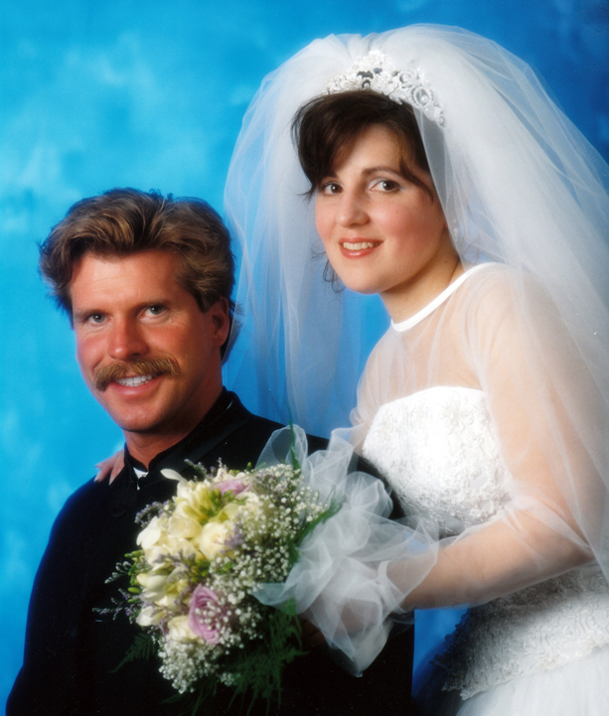
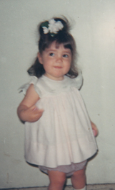
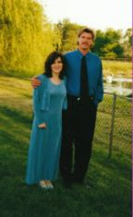
Michael & Margaret (Silva) Bishop Family
Child #2 – Laura (Bishop) Fox
Thomas & Laura (Bishop) Fox
Married on May 20, 2000
Tom Fox & Laura Bishop (Engaged -Spring of1999)
Laura (Bishop) Fox
Age 2

Slide 12
Arthur Aloysius Bishop Family Genealogy continued:
Children of Arthur Aloysius Bishop continued:
4) Name: Michael Alfred Bishop Sr.
Nickname: Mike
Born: August 30, 1939
Location: St. Joseph Hospital, Flint, MI – Genesee County
Address: 3512 Sandhurst Drive
City/State: Lansing, MI 48911
Telephone: 517-394-5581
Married: Margaret (Meg) Silva Father: Peter Silva
Wedding Date: July 7, 1962 Born: November 1, 1908
Place: St. Mary’s Cathedral, Saginaw, MI – Saginaw County Location: Mexico
Born: October 13, 1938 Deceased: March 22, 1952
Location: Merrill, MI – Saginaw County Mother: Rose Castillo
E-mail: mickybees@gmail.com Born: October 1, 1919
Location: Mexico
Children: Deceased: December 31, 2001
1) Name: Michael Alan Bishop Jr.
Nickname: Mike, Mikey, Bish
Born: January 25, 1965
Location: Walter Reid Hospital, San Antonia, Texas – Bexar County
Address: 8607 Carlsbad Lane
City/State: Lansing, MI 48917
Telephone:
Married: Celeste Ann Fata Father: Ernest Fata
Date: April 29, 1989 Born: September 13, 1928
Place: St. Gerard Church, Lansing, MI – Eaton County Location: Lansing, MI – Ingham
Born: April 17, 1967 Deceased:
Location: St. Lawrence Hospital , Lansing, MI – Ingham County Mother: Teresa Casteloni
E-mail: mikeb.llps@comcast.net Born: May 6, 1935
Location: Lansing, MI – Ingham
Children: Deceased:
1) Name: Christina Margaret Bishop
Nickname: Stino, Steeny, Chris, Tina
Born: June 1, 1991
Location: St. Lawrence Hospital, Lansing, MI – Ingham County
2) Name: Marisa Nicole Bishop
Nickname: Reese, Roosk, Rocket, Shoogs
Born: April 22, 1994
Location: St. Lawrence Hospital, Lansing, MI – Ingham County
2) Name: Laura Lynn (Bishop) Fox
Nickname:
Born: July 7, 1966 (on Mom & Dad’s 4th anniversary)
Location: Ingham Medical Center, Lansing, MI – Ingham County
Address: 11764 Ransom Highway
City/State: Dimondale, MI 48821
Telephone: 517-646-6214
Married: Thomas John Fox Father: Robert Fox
Date: May 20, 2000 Born: February 4, 1941
Place: Mt. Hope Church, Lansing, MI – Eaton County Location: Lansing, MI – Ingham
Born: August 22, 1963 Deceased:
Location: St. Lawrence Hospital, Lansing, MI – Ingham County Mother: Patricia Link
E-mail: Born: February 8, 1941
Location: Lansing, MI – Ingham
No Children Deceased:
Two cats: Blue and Callie

